Slide 1
Modeling Plants, Sensors & Actuators
Ramesh S

Slide 2
Model based development
Model
Environment Model
Link Model
Plant Model
Link Model
Controller Model
Plant
Controller
Environment
Real System

Slide 3
Modeling Plants
Involves identification of physical variables governing the plant behavior
Plant variables are continuous or real values variables
model how these plant variables vary over time and respond to control inputs and environmental changes
Algebraic and/or Differential Equations over the plant variables
Example: For thermostat controller, plant variable include room temperature, humidity level
T > tmax
off
on
T’ = K1
T’ = K2
T < tmin

Slide 4
Why model plants?
To design and validate controllers
Modeling involves right level of abstraction
Physical systems are quite complex and often not necessary for modeling all aspects of physical phenomenon
Especially for control system design and validation
Models are used for the design of physical plants themselves but these tend to be quite elaborate
Not needed for control system design and validation
Physical models often measured by the degrees of freedom that they possess
Higher the degrees of freedom more complex the model
3-DoF models and 6-DoF models in aircraft and automotive design

Slide 5
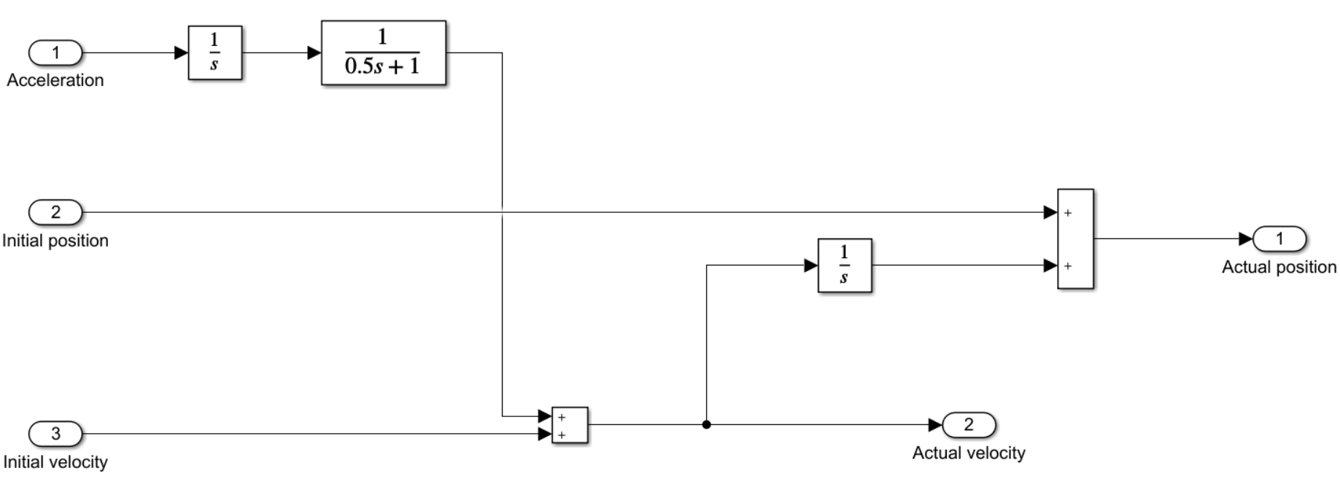
Vehicle Models
Vehicles are multi-body systems - complex interconnection of rigid and flexible bodies
When engine produces thrust various tensile and shear forces operate to make the vehicle move
Faithful modeling requires multi-body simulation
Simple models use lateral and longitudinal velocity, accelerations, position are some of the important variables,
More complex modeling involves tire pressure, surface friction are also variables for complex modeling
Kinematic models - algebraic equations involving velocity, acceleration and position
Low Speed Maneuvers, No/Little lateral motion, no surface slip assumed
Dynamic Models – differential equations considering forces
High speed Manuevers, Lane Change and Obstacle avoidance controllers

Slide 6
Commercial Vehicle Models
Elaborate commercial vehicle models available and used in practice
MSC Adams, ANSYS Motion
Modeling tires and tire forces on roads are the most complex
For Design & Development of Vehicle Controls
Models the behavior of vehicles for different road conditions under different driver inputs like throttle, brake and steering
e.g., Carsim (AI), CarMaker (IPG Automotive)
Extensively used by several automotive companies

Slide 7
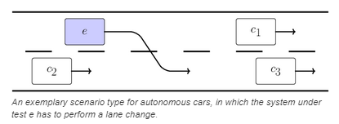
Environment Modeling
Besides plants, sensors/actuators, environment objects also requires modeling
In the case of automated driving systems, 3d environment objects like roads, road-side objects like signals, lane markers, building, pedestrians , intersections are all to be modeled.
Powerful simulation engines are being used in creating scenes and scenarios
Applied Intuition, dSpace, ANSYS, Open source tools (Carla)

Slide 8
Environment Modeling
Environment plays a crucial role in most embedded systems
Environment includes elements external to, (partially) observable but not directly controllable by the controller
Contrast with the plant
They may involve physical and human element
In the case of automotive systems, the environment is the 3D object world
Roads, Road Signals, Other vehicles, Pedestrians (VRUs), Trees, side walks, lanes, buildings, etc.
Weather and weather-related objects, lighting conditions,
Modeling involves identification and digital representation of appropriate aspects of the environmental elements
Focus on aspects that concern the controller
Focus on aspects that impact the sensors (e.g., surface reflecivity)
These include
Road geometry, Road physics
Road object physics (shape, surface reflectivity, position, velocity and acceleration)
Weather - Rain/snow (low, medium & heavy),
Lighting (dark, bright, nominal)

Slide 9
Scenes and Scenarios
Digital representation of environment
A scene has
background (sky, paved and unpaved areas, sidewalks, etc.)
Static objects (e.g., signboards, buildings, trees, bushes, etc.
Dynamic actors (ego vehicle, other vehicles, signals, pedestrians, etc.)
Each dynamic actors is associated with a behavior
Vehicles and pedestrians have trajectories
Signals periodically change
A scenario is timed sequence of scenes
Background and static objects change from one scene to another depending upon the workd
Dynamic actor change as per their behaviors
Scenario description languages
Open Scenario 2.0
Scenes and scenarios
Are rendered as photo-realistic images in gaming engines (Unity, Unreal)
Enabled by Nvidia RTF technology
Edited to create or revise new scenes and scenarios (Mathworks Roadrunner)

Slide 10
Real to Virtual
Several companies are involved in creating digital representation of all the roads and road-side static objects
Open Street map

Slide 11

Radar Scene Emulator

Slide 12
Sensing: Basic Concepts
Ramesh S

Slide 13
Sensors
Sensors and sensor circuitry are fundamental to embedded systems
Involve transduction of external physical parameters to electrical parameters
Physical parameters are temperature, pressure, acceleration, concentration, etc
Electrical Parameters are: Voltage, Current, Resistance, Capacitance
This is a classical definition applicable to small restricted class of embedded devices
A very general definition required for modern AI based applications like self driving cars, large scale IoT devices
Eg., collision avoidance system need to sense `collision situation’, Conference room adjust the lighting and sound `sensing’ (inferring) the number and spread of attendees
Philosophy and Psychology have very general definition
Sensing involves creating a `consistent model’ of the external phenomenon/envn.

Slide 14
Sensors
Sensor
s(t)
r(t)
Plant

Slide 15
Sensor/Actuator Modeling
A variety of sensors used in embedded systems
Temperature, pressure and touch sensors, gyroscopes
Wheel speed sensors, Accelerometers, GPS devices
Cameras, Radars, Lidars
Sensor modeling important aspect in MBD
Simple sensors are transducers that convert some physical parameters into digital variables
The simplest model of an ideal sensor is an affine function:
S = f(X) = aX + b, a is called sensitivity and b is the bias
X, is the physical parameter and S is the corresponding digital signal or value
In reality, there will be range for a sensor
Other aspects to be considered are noises and distortions
A common way of modeling simple sensors is as a transfer functions

Slide 16
Sensor Challenges
Physical parameter varying over time and the challenge of sensors is to follow and capture accurately the changes
s(t) = F(r(t)), for all time points, t
What is an ideal sensor?
s(t) = K * r(t), for all t
Constant gain sensor
Also, ideally K is very high so that small changes in input are discernible – high sensitivity
Why is this ideal?
Inverse function is easy to construct
Why do you need to construct inverse function?

Slide 17
Sensor Characteristics
Static Characteristics
Properties of the sensors in the steady state after all transient effects are settled
Accuracy
Resolution
Precision
Sensitivity
Linearity
Hysteresis
Dynamic Characteristics
Sensor properties under changes in physical parameters
Zero, first and second order systems

Slide 18
Accuracy, Resolution, Precision
Accuracy of a sensor determines the error in measurement
Absolute Error, Relative error = abs. error/ true value
Resolution is the smallest change in the parameter that are detectable or measurable by the sensor
A precise sensor is one that measures/senses the same value when the actual values are the same
Sensitivity is a measure of the slope of the I/O curve
I/O curve is also called calibration curve
Linearity is a measure of closeness of the curve to a straight line
Monotonicity
Hysteresis is measure of the difference in measured values of the parameter value reached from

Slide 19
Dynamic Characteristics
Static characteristics of a sensor describes the behavior under nonvarying inputs
Dynamic behavior describes the sensor outputs under changing inputs
The inputs can change in a variety of ways
Impulse, Step, Linear, Sinusoidal, Mixed With High and Low Frequency Noise

Slide 20
Sensor Response
How should a sensor response be for varying inputs
Ideally, sensor should transduce faithfully and instantaneously the intended changes in input
Constant gain sensor for all frequency range – infinite bandwidth
Difficult to achieve in practice
Real sensors will have some storage element
Eg., Typical accelerometers will have a mass spring arrangement
Temperature sensors will have heating element that has associated delay
Real sensors have ranges of operations
Linear behavior in some range
Non-linear behavior, saturation outside the range
Real sensors have finite bandwidth

Slide 21
Transfer Function
Dynamic Behavior of a sensor is characterized by a transfer function
Inputs and outputs are related, in general, by differential equations
The order of the differential equation determines the order of the sensor
Zero order sensor: Potentiometer measuring linear and rotary displacements
First order sensor: Thermocouple measuring temperature changes
Second order sensor: Accelerometer

Slide 22
Dynamic Model of Sensors
The dynamic response of a sensor often defined by a linear differential equations
Using Laplace transforms this can be converted into algebraic equations:
Transfer function is then
Poles and Zeros decide the behavior of the sensor

Slide 23
Relating Poles and Sensor Behaviors

Slide 24
First Order Sensor
Transfer Function: G(s) =
Step Response:
A – step size
k is static gain
τ is Time constant
Ramp Response

Slide 25
First Order Sensor Response

Slide 26
Second Order Transfer Function
Transfer function

Slide 27
Second-order Step Response

Slide 28
Second-Order Response

Slide 29
Other Issues with Sensors
Sensor power might be limited to drive the controller or load
Sensor has an output impedance
For voltage sensors, the output impedance need to be very small
For current sensors, the output impedance need to be very high

Slide 30
Sensor Errors
Systematic Errors
Inherent transduction process error
Drifting due to age
Transmission Errors – attenuation
Loading Error – measurement changes the value
Saturation, Non linearities
Random Errors
Noise is everywhere
White Noise (Gaussian Noise)
Environmental Interference – 60Hz hum
SNR >> 1
Digital Inputs too subject to noise
Debouncer circuits

Slide 31
Sensor Circuitry
Elaborate interfaces often required for sensors in view of the above issues
The interface circuitry includes
High input impedance devices (voltage sensors)
High Gain Amplifiers
Buffers
Filters
Many microcontrollers (e.g., PSoC4) enables developing sensor specific interfaces by providing a number of analog blocks
OpAmps – Operational Amplifiers

Slide 32




OpAmps
Schematic Symbol
Very High Gain Differential Amplifier
Active Circuit with a power supply
I/O with respect to a ground
Voltage Amplifier
+V, -V external supply
+V
Non Inverting
Input
+
+
Output
Inverting Input
-
- V

Slide 33
What is an amplifier?
Rs – Source Resistance
RL – Load Resistance
Vs – Source Voltage
Vo – Output Voltage
Vo = Gain * Vs
Rs
Vo
Amplifier
Vs
R_{L}

Slide 34
Amplifier – Equivalent Circuit
R_{in} – Input Resistance
R_{out} – output Resistance
V_{in} – Voltage across R_{in} input to the amplifier
Fraction of Vs
A – Voltage Gain
Rs
R_{out}
Vs
V_{in}
R_{in}
+
A
V_{L}
-
R_{L}
A x V_{in}

Slide 35
Ideal OpAmp
Input Resistance Rin is infinity
Output Resistance Rout is zero
Amplifier Gain A is infinity
A – Open loop gain
+ V
+
Vp
Rin
Rout
+
-
A*Vd
Vn
-
- V

Slide 36
Negative Feedback
Connect the output of the Opamp to the inverting input
Input is connected to the inverting input
What is the relation between V_{s} and V_{o} ?
What is the input voltage to OpAmp? Vp – Vn
R_{f}
R_{s}
-
V_{n}
V_{p}
+
V_{o}
V_{s}

Slide 37
Analysing Ideal OpAmp
The inverting amplifier is equivalent to the below figure. How?
Simple circuit analysis will show that
Vout = - [R_{f}/(Rs)] * Vs
Output is inverted in sign compared to input
Inverting amplifier
Closed loop gain independent of the gain of OpAmp!
Chosen by adjusting the values of feedback resistance
R_{f}
Rs
V_{out}
V_{n}
V_{s}
A_{o}V_{in}
V_{p}

Slide 38
Important Properties of Ideal OpAmp
With Negative feedback
What is the input voltage applied to the OpAmp?
The Input Voltage Constraint:
Vp = Vn
It is virtual short circuit
What is the current flowing in/out of OpAmp?
The input current constraint:
Ip = In = 0
It is a virtual open circuit

Slide 39
Versatility of OpAmp
OpAmp appears to be a paradoxical circuit
But a very powerful and versatile component
Important building block in Analog Circuits
They can be used to build a variety of functionality
Inverting and noninverting amplifiers, Voltage follower or buffer
Converters, Filters, Comparators
Arithmetic and Logical Operations – Hybrid Computers

Slide 40
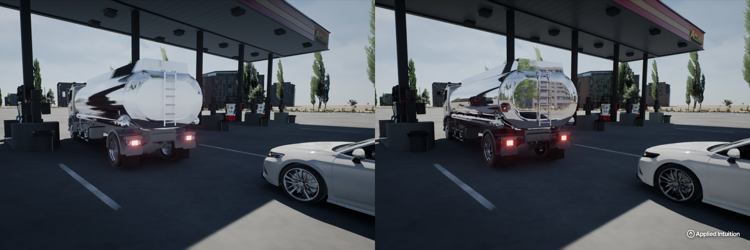
More Complex Sensors
Elaborate techniques required for modeling sensors like Cameras and radars
Cameras are sensors that convert 3D physical world scenes into pixel values
A model needs to do the same: inputs 3D objects and outputs pixel values
There are two main approaches used for modeling cameras
Rastering and Ray Tracing
Rastering involves computing projections and less expensive and accurate compared to ray tracing
Ray tracing traces different rays of light going from source to the camera
Effects of camera lenses need to be modeled

